Slide 1

Embedded Software Programming
Ambuj Varshney
ambujv@nus.edu.sg
Notes:
++ Thank you for inviting me to give this talk
++ In this talk, I will present a pathway that can enable us to make wireless embedded systems ubiquitous. I will describe my previous research efforts that tackle the critical challenges that limit the growth of wireless embedded systems. These are related to the growing energy asymmetry that exists between sensing, computation and communication blocks on these platforms.
++ Finally, I will conclude my talk by covering the research agenda that I would like to work on as a faculty member.

Slide 2
Sensing and Actuation
Notes:
++ Over the past few years, I have designed several backscatter and beyond backscatter systems that precisely overcome these critical challenges that have limited the widespread deployment of backscatter on IoT devices.
++ The research vision that I have pursued and would like to pursue as a faculty member is to enable a massive deployment of IoT devices by bridging the energy asymmetry between sensing, computation and communication blocks by designing novel platforms and communication mechanisms. I am going to describe some of my research contributions next.

Slide 3
Course Information
Notes:
++ Over the past few years, I have designed several backscatter and beyond backscatter systems that precisely overcome these critical challenges that have limited the widespread deployment of backscatter on IoT devices.
++ The research vision that I have pursued and would like to pursue as a faculty member is to enable a massive deployment of IoT devices by bridging the energy asymmetry between sensing, computation and communication blocks by designing novel platforms and communication mechanisms. I am going to describe some of my research contributions next.

Slide 4
General information regarding the course
Course code: CS 5272, Day of week: Monday, 6:30pm to 8:30pm
Plan for a lecture duration between 1-1.5 hours!
Office hours: COM3 - #2 – 25, Thursday : 4 – 6 pm (by appointment)
Please send me an email to reserve slot
What can you discuss? Anything related to course or wireless networking
Notes:
++ We may all have heard of the term Internet of Things. So how are these wireless embedded systems related to the Internet of Things: Today, IoT includes a broad class of devices, including powerful platforms such as smartphones. However, it also includes more resource-constrained devices and what we call Wireless Embedded Systems, and in fact, I consider it to be one of the essential parts of the IoT ecosystem.
++ These are platforms equipped with a radio transceiver, sensor, microcontroller, and some form of energy storage. These platforms also often form a network, and sensor network as it is called has been an active area of research for the past two decades.
++ The research community has also developed wireless embedded platforms which we may know about, and these include: CMUCAM, which is an image sensor platform developed at Carnegie Mellon University, or Permamote is long life sensor platform from the lab I am associated with at UC Berkeley or Lorea which is a long-range backscatter platform that I had developed as part of my doctoral dissertation at Uppsala University. All of these are an example of Wireless Embedded Systems.

Slide 5
Course webpage and other resources
There are no prescribed textbooks for the course
Lectures, reading of research paper, and learning through project
Course webpage: https://weiserlab.github.io/embeddefsoftware/
Provides a list of research papers and other course resources
Canvas will be used for the submission of term report, project
Video from the first lecture is already made available on canvas
Notes:
++ We may all have heard of the term Internet of Things. So how are these wireless embedded systems related to the Internet of Things: Today, IoT includes a broad class of devices, including powerful platforms such as smartphones. However, it also includes more resource-constrained devices and what we call Wireless Embedded Systems, and in fact, I consider it to be one of the essential parts of the IoT ecosystem.
++ These are platforms equipped with a radio transceiver, sensor, microcontroller, and some form of energy storage. These platforms also often form a network, and sensor network as it is called has been an active area of research for the past two decades.
++ The research community has also developed wireless embedded platforms which we may know about, and these include: CMUCAM, which is an image sensor platform developed at Carnegie Mellon University, or Permamote is long life sensor platform from the lab I am associated with at UC Berkeley or Lorea which is a long-range backscatter platform that I had developed as part of my doctoral dissertation at Uppsala University. All of these are an example of Wireless Embedded Systems.

Slide 6
How would the student’s performance be graded
Component | Weightage to Overall Grade
Project | 50 %
Student Seminar | 20 %
Term Paper | 30 %
If we decide to have final-assessment, the above percentage may change

Slide 7
Important Deadlines
Event | Date
Lectures | Starting Week 1 (15th January)
Student seminar paper selection | End of recess week (10th March)
Finalising project statement | End of recess week (10th March)
Student seminars | Lectures from 18th March
Project presentation | 15th April 2024
Term paper submission | 19th April 2024
Project submission | 19th April 2024

Slide 8
Roadmap of the lecture today
We review some of the important points from the last lecture
What are sensors? Two main categories of sensing modality
Basics of sensing, ADCs, and interfacing sensors with microcontroller
Sensing using potential changes, other sensors
Case study: Visible Light Sensing, Actuation
Notes:
Here is the roadmap of the major topics that I am going to cover during the presentation. We have already covered the exponential growth of the internet of things; next, I will talk about the critical energy challenge that can severely hinder this massive growth and preventing us from realising this immense economic value enabled by the IoT.

Slide 9
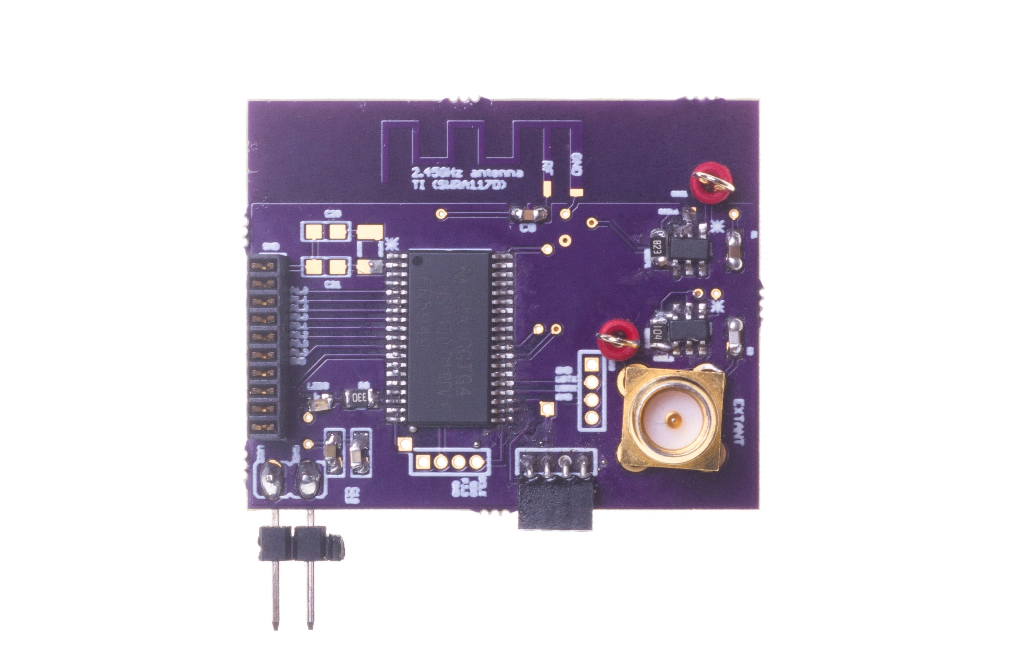
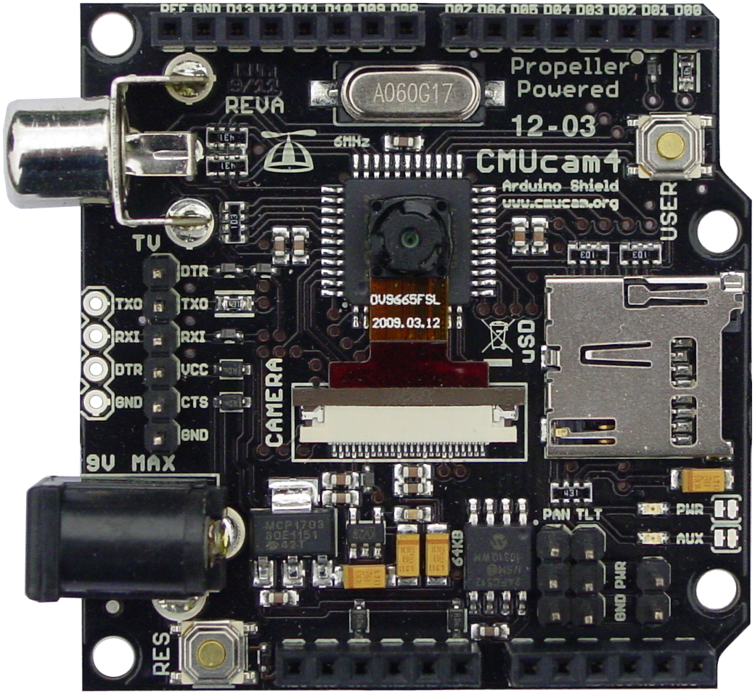
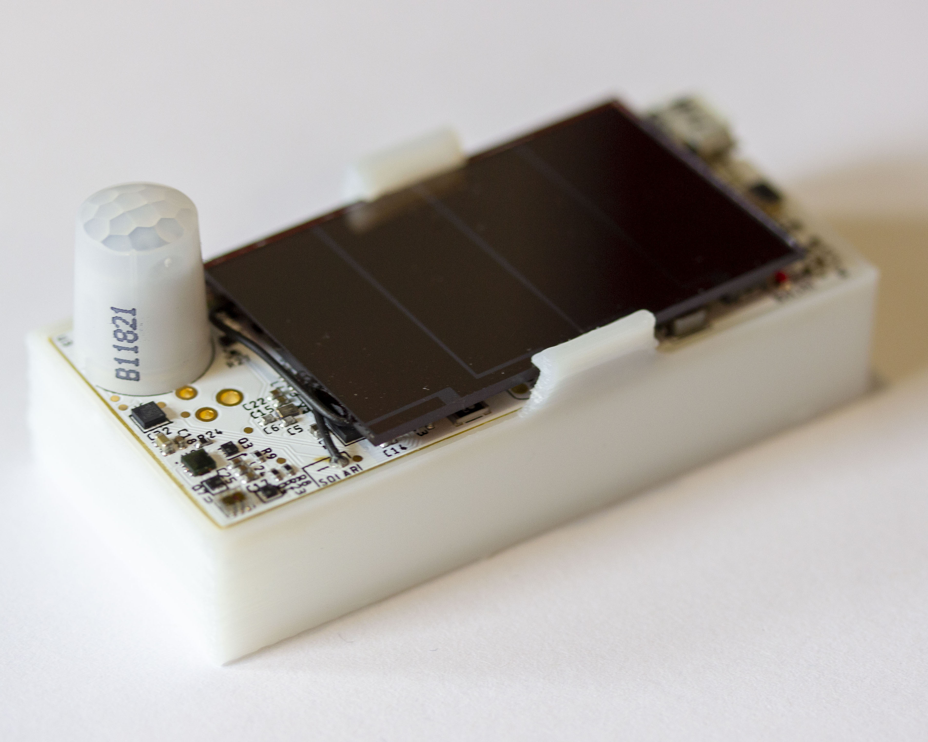
Internet of things and wireless embedded systems
Wireless embedded systems (WES) are platforms equipped with radio transceiver, sensors, microcontroller and some form of energy storage
WES are an important part of the internet of things (IoT) ecosystem
CMUCam
[Carnegie Mellon University]
Permamote
[University of California, Berkeley]
LoRea
[Uppsala University]
Notes:
++ We may all have heard of the term Internet of Things. So how are these wireless embedded systems related to the Internet of Things: Today, IoT includes a broad class of devices, including powerful platforms such as smartphones. However, it also includes more resource-constrained devices and what we call Wireless Embedded Systems, and in fact, I consider it to be one of the essential parts of the IoT ecosystem.
++ These are platforms equipped with a radio transceiver, sensor, microcontroller, and some form of energy storage. These platforms also often form a network, and sensor network as it is called has been an active area of research for the past two decades.
++ The research community has also developed wireless embedded platforms which we may know about, and these include: CMUCAM, which is an image sensor platform developed at Carnegie Mellon University, or Permamote is long life sensor platform from the lab I am associated with at UC Berkeley or Lorea which is a long-range backscatter platform that I had developed as part of my doctoral dissertation at Uppsala University. All of these are an example of Wireless Embedded Systems.

Slide 10
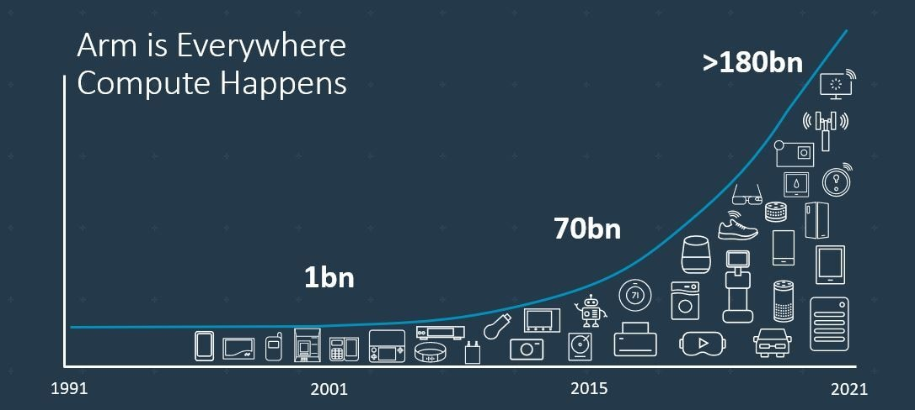
Trillion embedded devices will be deployed soon
Fourth quarter of 2020. Arm shipped 4.4 billion Cortex-M processors
ARM Press Release (Feb 11, 2021) reporting on Fourth Quarter 2020
Notes:
++ Due to the numerous applications that the internet of things enables, we are witnessing a massive growth in the number of microcontrollers being sold. These microcontrollers form the heart of the IoT platforms.
++ To illustrate this point: ARM, a popular UK based company, just reported numbers, and in these numbers, they state that they sold 4.4 billion cortex M processors in just one quarter. These microcontrollers are almost exclusively used on IoT platforms, which demonstrates the massive growth we are witnessing in the number of deployed IoT devices.
++ If this growth continues, and in fact, I believe this growth will accelerate, we will soon have a trillion embedded devices that are going to be deployed in the world.

Slide 11
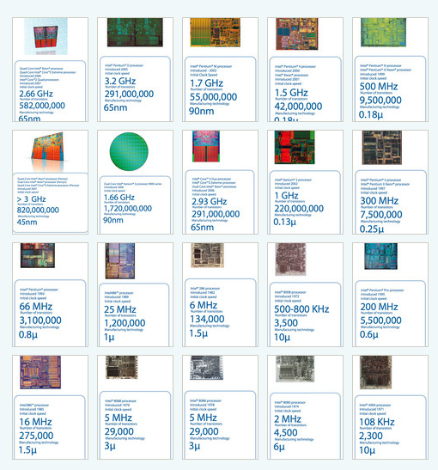
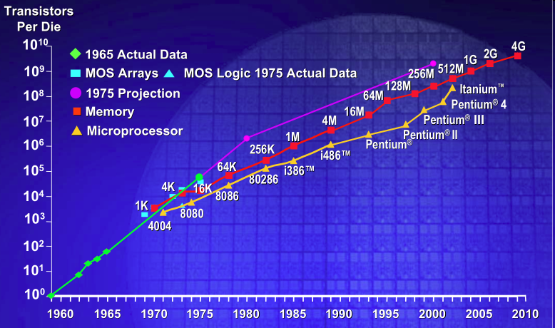
IC transistor count doubles every two years
Photo Credit: Intel
Notes:
So if we look at the computing spectrum today, each of the classes exist simultaneously. In a room we can put 100s of teraflops and many petabytes of computing.
Our productivity, document preparation, and personal information management fits in our pocket and a new class is emerging that will provide a means of streaming information to and from the physical world like we have never seen before.

Slide 12
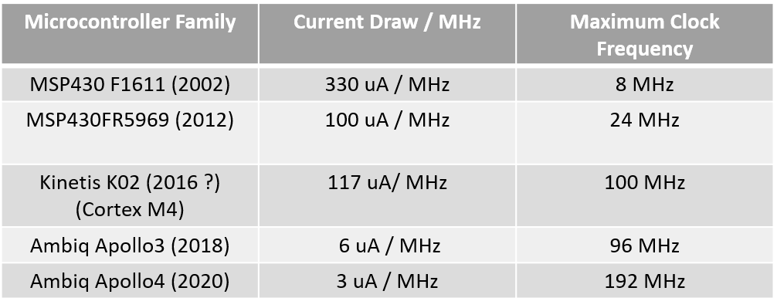
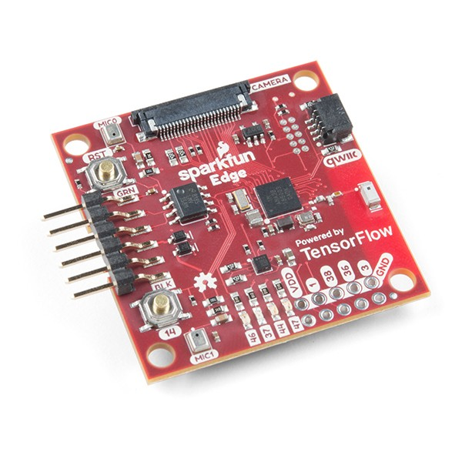
Computation is becoming energy inexpensive
Today, computation is at least an order of magnitude more energy expensive than performing a sensing operation
Digital components are becoming energy efficient (Moore’s law)
We can expect power consumption for computation to match sensing
Ambiq Apollo3
Notes:
First, we look at the computational elements, and these consist of a microcontroller or an FPGA. Today, we find that these computational elements consume at least one order of magnitude higher power consumption when compared to the commonly used sensors.
However, we also find that microcontrollers are increasingly becoming energy efficient. We investigate a typical microcontroller that has been used in sensor platforms over the past two decades. We find that energy efficiency has improved by almost two orders of magnitude. Some of the present-generation microcontrollers, such as Ambiq Apollo4 consume just 3 uA/MHz than 330 uA for MSP430 used on platforms such as TelOS B.
If the trend continues, we can expect the microcontrollers to catch up with the sensors and become energy-efficient. This significant improvement is that the digital components are increasing becoming efficient as they follow moore’s law.

Slide 13
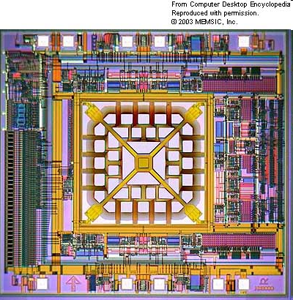
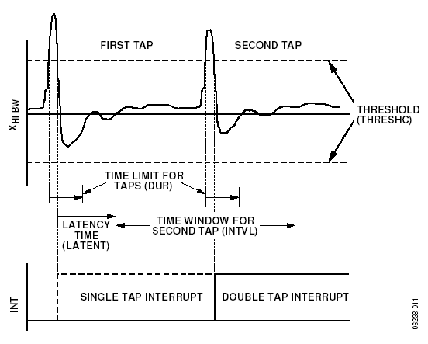
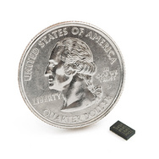
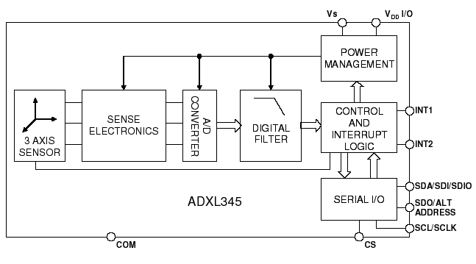
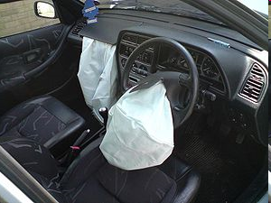
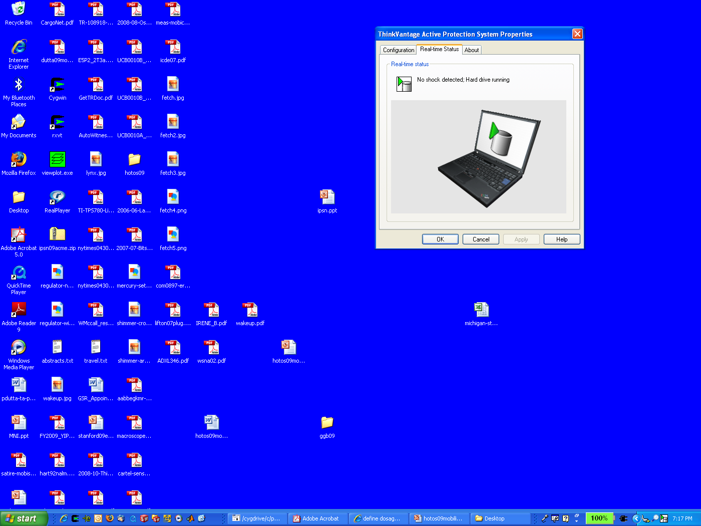
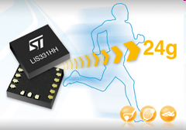
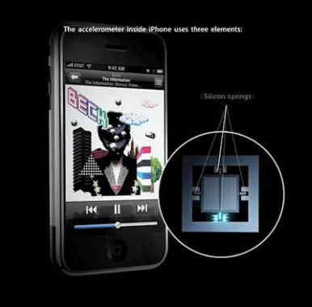
MEMS Accelerometers: Rapidly falling price and power
O(mA)
Price
Power
25 µA @ 25 Hz
ADXL345
[Analog Devices, 2009]
10 µA @ 10 Hz @ 6 bits
[ST Microelectronics, annc. 2009]

Slide 14
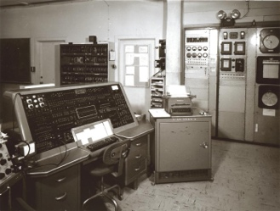
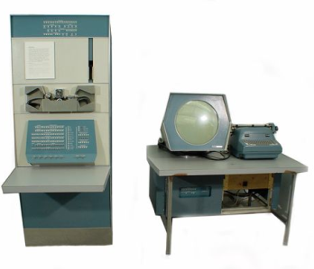
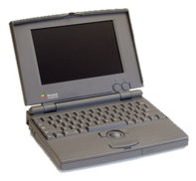
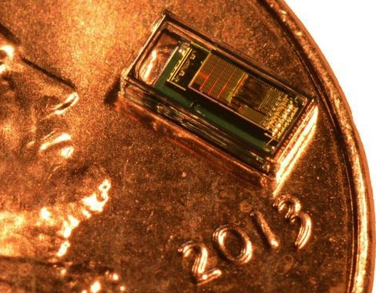
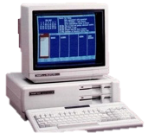

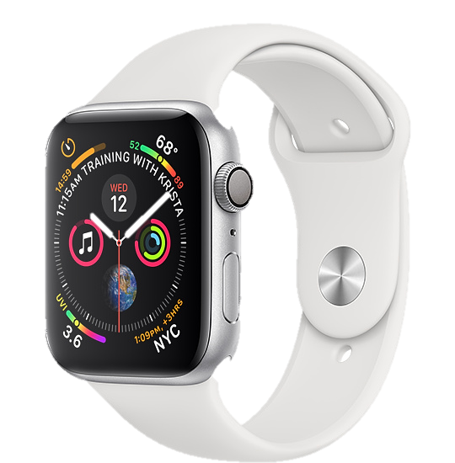
Trillion embedded devices will be deployed soon
Mainframe
“Roughly every decade a new, lower priced computer class forms based on a new programming platform, network, and interface resulting in new usage and the establishment of a new industry.”
1 per Enterprise
Workstation
1 per Engineer
[Bell et al. Computer, 1972, ACM, 2008]
Smart Dust
Laptop
100 – 1000’s per person
log (people per computer)
1 per Professional
IoT/Wearable
Mini Computer
10’s per person
1 per Company
Personal Computer
1 per Family
Smartphone
1 per person

Slide 15
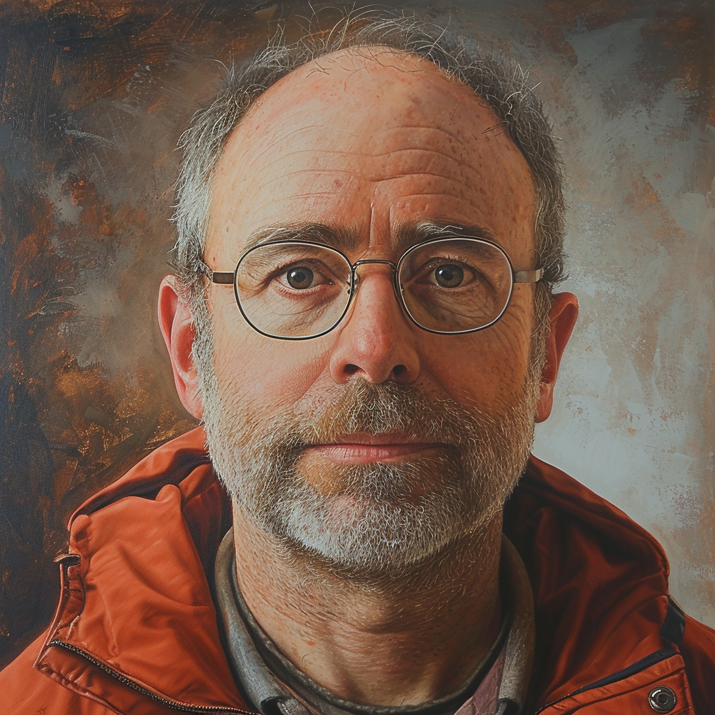
Mark Weiser vision of ubiquitous computing
Mark Weiser (1952 – 1999)
PhD (University of Michigan), CTO at Xerox PARC
Considered “Father” of ubiquitous computing
He is a highly influential figure in the area
What is ubiquitous computing?

Slide 16
Mark Weiser vision of ubiquitous computing
“Ubiquitous computing names the third wave in computing, just now beginning. First were mainframes, each shared by lots of people. Now we are in the personal computing era, person and machine staring uneasily at each other across the desktop. Next comes ubiquitous computing, or the age of calm technology, when technology recedes into the background of our lives.”

Slide 17
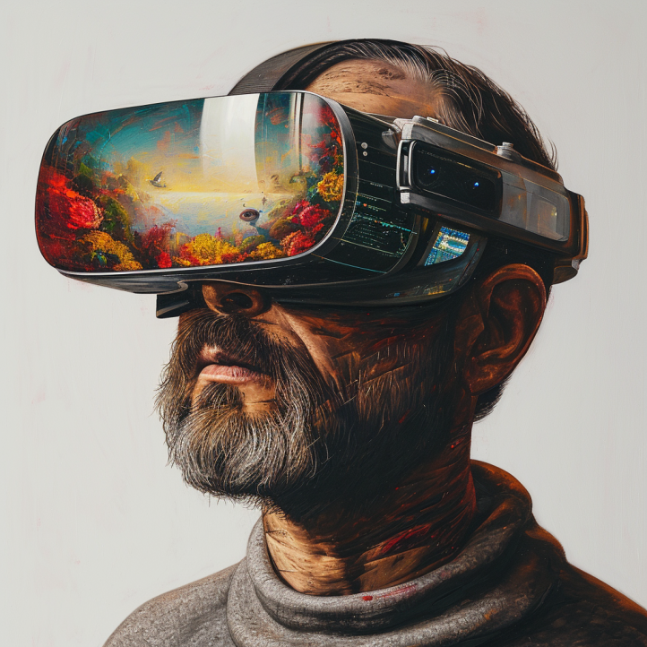
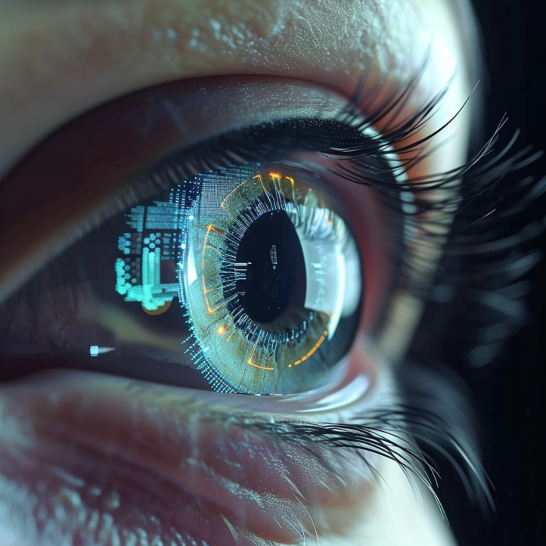
Mark Weiser vision of ubiquitous computing
What are upcoming technologies that may become ubiquitous?

Slide 18
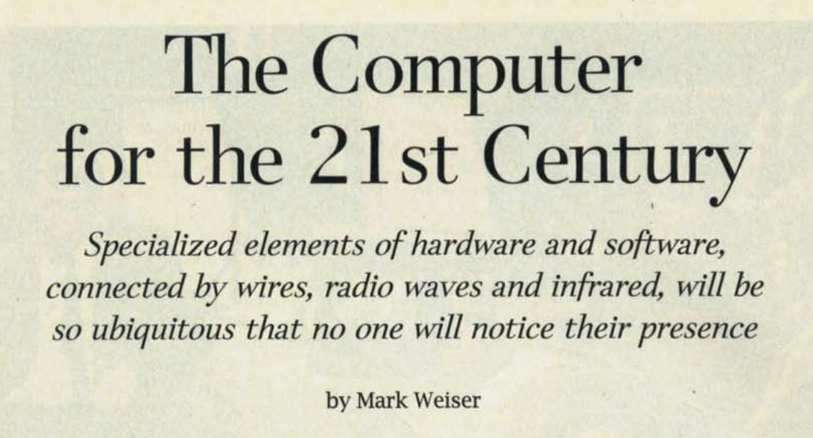
Mark Weiser vision of ubiquitous computing
The Computer for the 21st Century, Scientific American, 1991

Slide 19
Roadmap of the lecture today
We review some of the important points from the last lecture
What are sensors? Two main categories of sensing modality
Basics of sensing, ADCs, and interfacing sensors with microcontroller
Sensing using potential changes, other sensors
Case study: Visible Light Sensing, Actuation
Notes:
Here is the roadmap of the major topics that I am going to cover during the presentation. We have already covered the exponential growth of the internet of things; next, I will talk about the critical energy challenge that can severely hinder this massive growth and preventing us from realising this immense economic value enabled by the IoT.

Slide 20
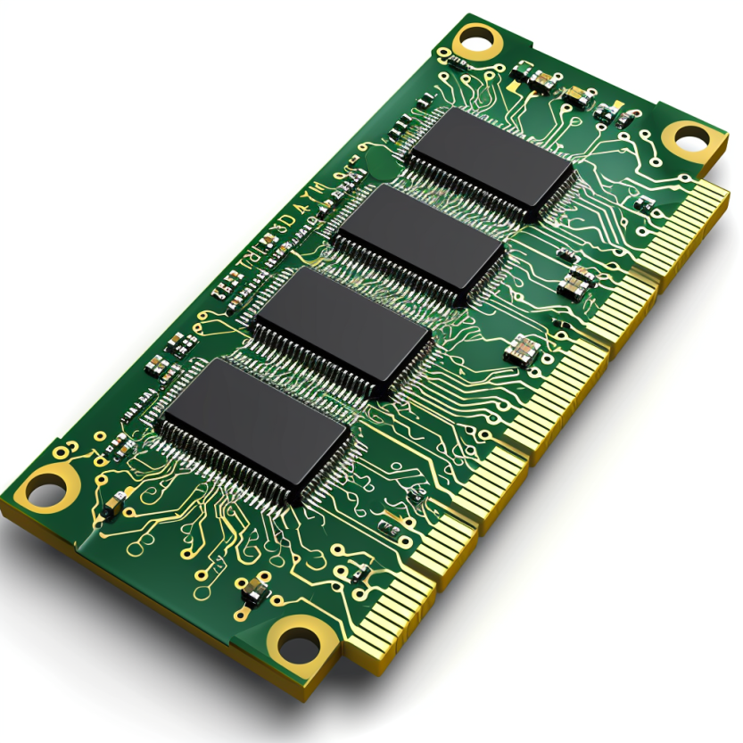
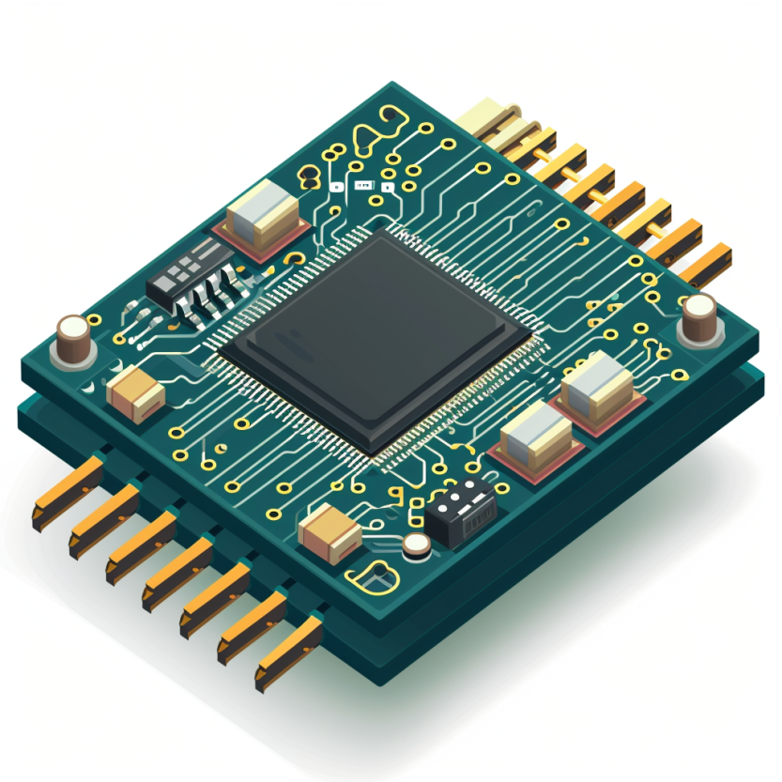




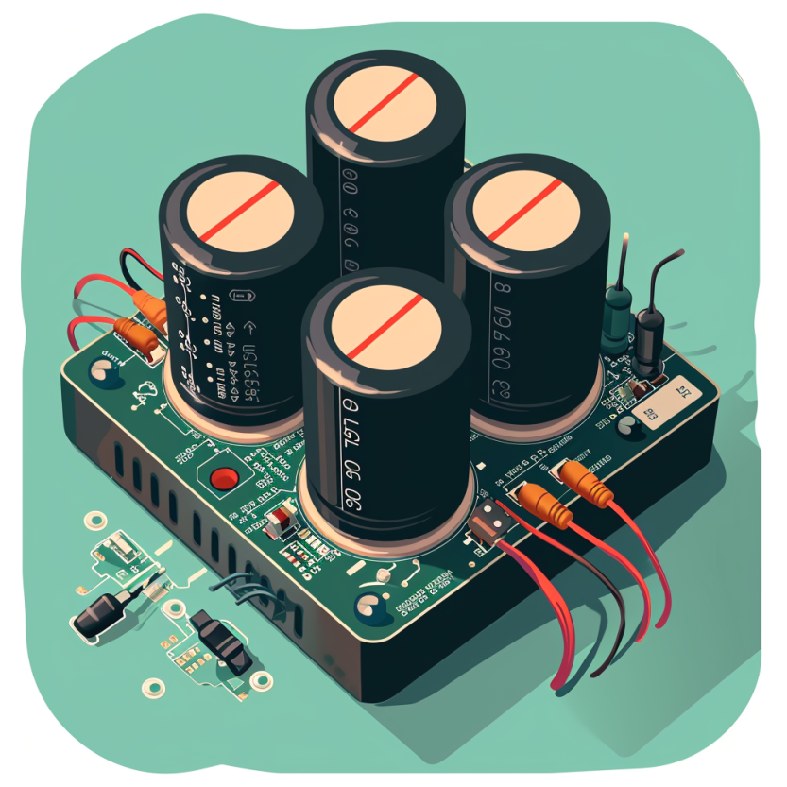
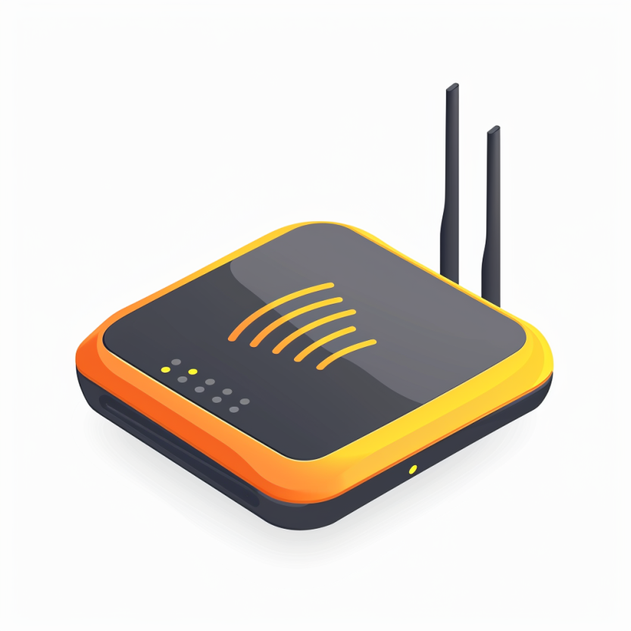

Four main tasks performed by an embedded device
Computation and Storage
Sensing and Actuation
Power
Management
Wireless Networking
Notes:
First, we look at the computational elements, and these consist of a microcontroller or an FPGA. Today, we find that these computational elements consume at least one order of magnitude higher power consumption when compared to the commonly used sensors.
However, we also find that microcontrollers are increasingly becoming energy efficient. We investigate a typical microcontroller that has been used in sensor platforms over the past two decades. We find that energy efficiency has improved by almost two orders of magnitude. Some of the present-generation microcontrollers, such as Ambiq Apollo4 consume just 3 uA/MHz than 330 uA for MSP430 used on platforms such as TelOS B.
If the trend continues, we can expect the microcontrollers to catch up with the sensors and become energy-efficient. This significant improvement is that the digital components are increasing becoming efficient as they follow moore’s law.

Slide 21
Four main tasks performed by an embedded device
Computation and Storage
Sensing and Actuation
Power
Management
Wireless Networking
Notes:
First, we look at the computational elements, and these consist of a microcontroller or an FPGA. Today, we find that these computational elements consume at least one order of magnitude higher power consumption when compared to the commonly used sensors.
However, we also find that microcontrollers are increasingly becoming energy efficient. We investigate a typical microcontroller that has been used in sensor platforms over the past two decades. We find that energy efficiency has improved by almost two orders of magnitude. Some of the present-generation microcontrollers, such as Ambiq Apollo4 consume just 3 uA/MHz than 330 uA for MSP430 used on platforms such as TelOS B.
If the trend continues, we can expect the microcontrollers to catch up with the sensors and become energy-efficient. This significant improvement is that the digital components are increasing becoming efficient as they follow moore’s law.

Slide 22
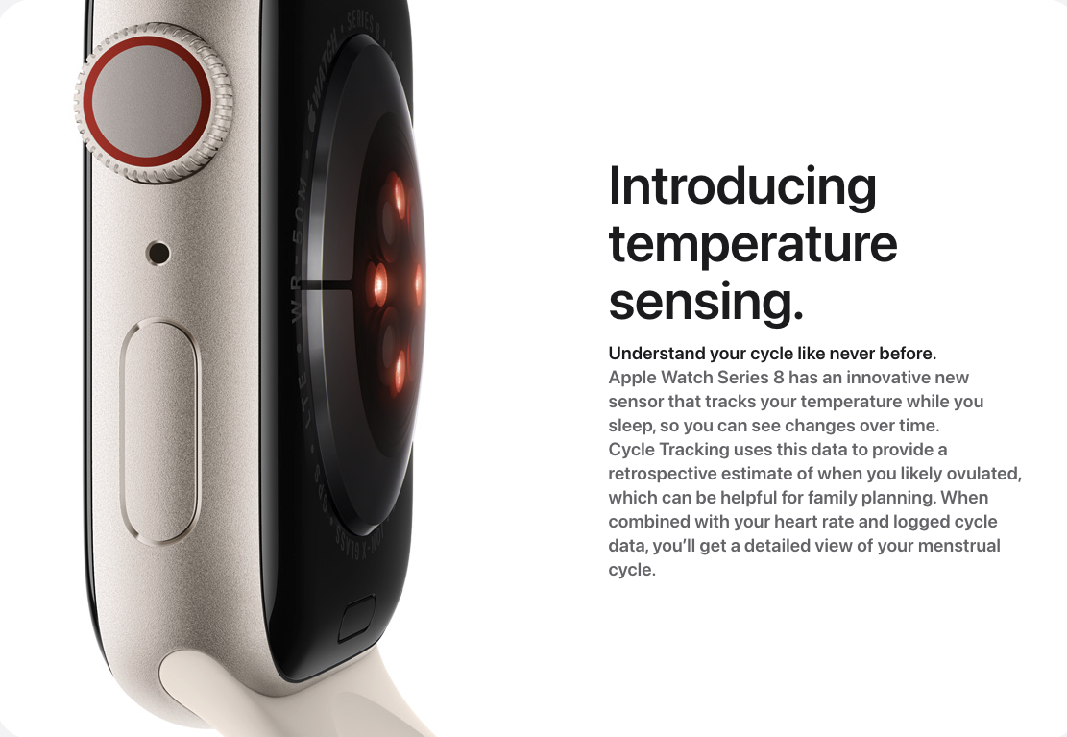
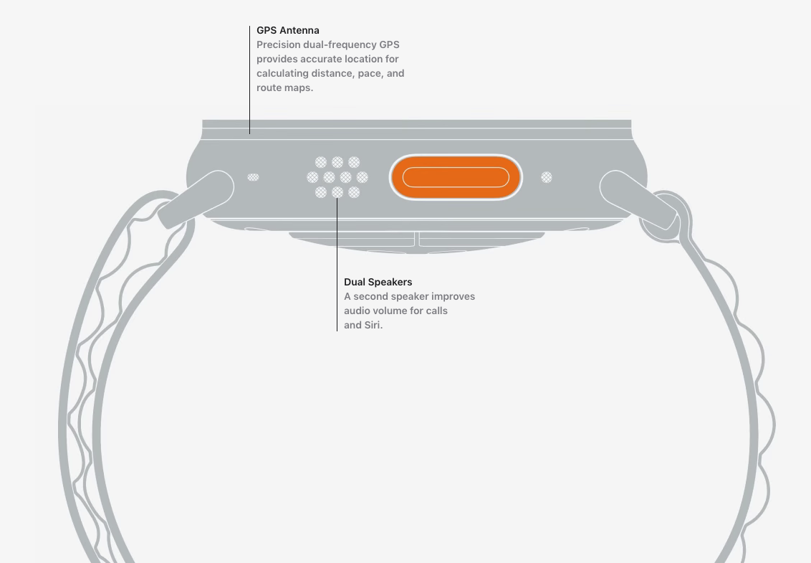
Sensors and actuators are an integral part of most consumer electronic devices
Essential part of almost all consumer electronic devices
They are an Interface of electronic devices with the physical world
Courtesy: Apple
Notes:
First, we look at the computational elements, and these consist of a microcontroller or an FPGA. Today, we find that these computational elements consume at least one order of magnitude higher power consumption when compared to the commonly used sensors.
However, we also find that microcontrollers are increasingly becoming energy efficient. We investigate a typical microcontroller that has been used in sensor platforms over the past two decades. We find that energy efficiency has improved by almost two orders of magnitude. Some of the present-generation microcontrollers, such as Ambiq Apollo4 consume just 3 uA/MHz than 330 uA for MSP430 used on platforms such as TelOS B.
If the trend continues, we can expect the microcontrollers to catch up with the sensors and become energy-efficient. This significant improvement is that the digital components are increasing becoming efficient as they follow moore’s law.

Slide 23
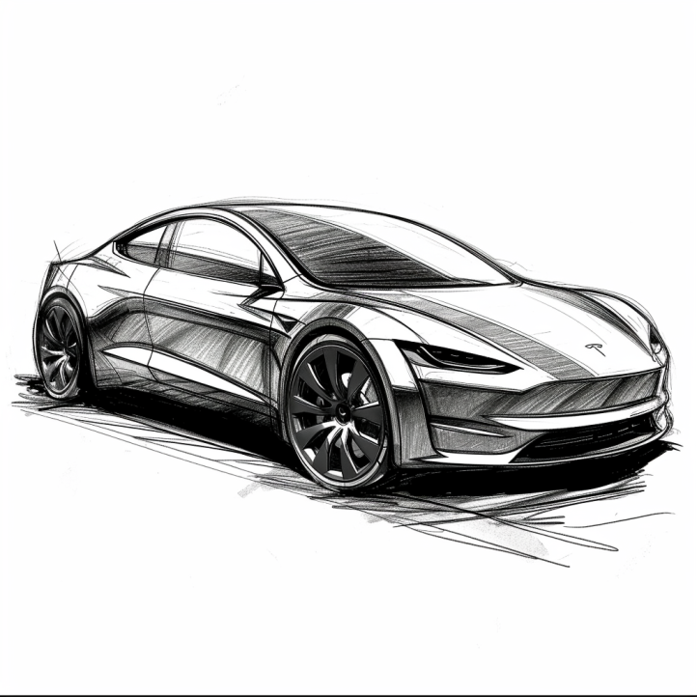
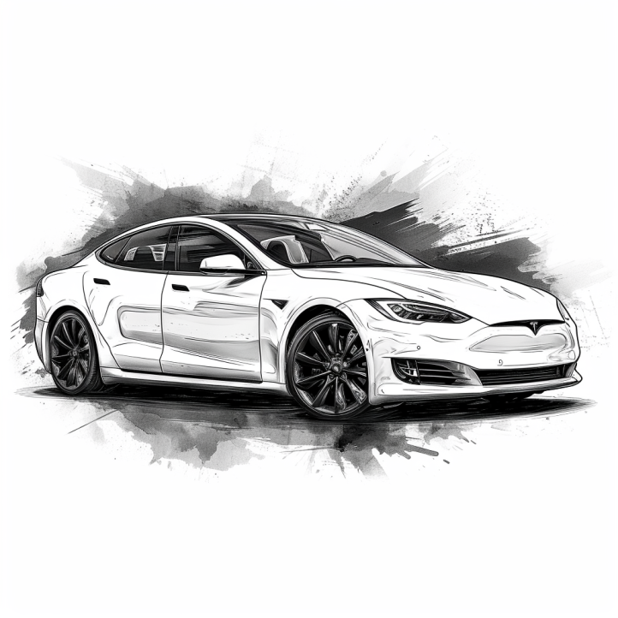
Cars are all software and sensors
Electric cars have numerous sensors and microcontrollers
Various sensors that are used in cars include:
Tracking location: GPS (global positioning system)
Distance measurement: Ultrasonic sensors
Terrain mapping: Lidar (light detection and ranging)
Proximity sensing: radar
Various forms of cameras
Motion sensor: accelerometers
…. And many more
Notes:
First, we look at the computational elements, and these consist of a microcontroller or an FPGA. Today, we find that these computational elements consume at least one order of magnitude higher power consumption when compared to the commonly used sensors.
However, we also find that microcontrollers are increasingly becoming energy efficient. We investigate a typical microcontroller that has been used in sensor platforms over the past two decades. We find that energy efficiency has improved by almost two orders of magnitude. Some of the present-generation microcontrollers, such as Ambiq Apollo4 consume just 3 uA/MHz than 330 uA for MSP430 used on platforms such as TelOS B.
If the trend continues, we can expect the microcontrollers to catch up with the sensors and become energy-efficient. This significant improvement is that the digital components are increasing becoming efficient as they follow moore’s law.

Slide 24
So, what are sensors ?
They are an eyes and ears for an embedded device. They sense environment and help to understand the physical world. Sensor is an electronic component that measures a physical phenomenon.
What are the phenomenon that you would like to sense and measure?
Temperature
Humidity
Acoustic
Vital signs
…….
Choice of sensor depends on the target embedded application
Notes:
First, we look at the computational elements, and these consist of a microcontroller or an FPGA. Today, we find that these computational elements consume at least one order of magnitude higher power consumption when compared to the commonly used sensors.
However, we also find that microcontrollers are increasingly becoming energy efficient. We investigate a typical microcontroller that has been used in sensor platforms over the past two decades. We find that energy efficiency has improved by almost two orders of magnitude. Some of the present-generation microcontrollers, such as Ambiq Apollo4 consume just 3 uA/MHz than 330 uA for MSP430 used on platforms such as TelOS B.
If the trend continues, we can expect the microcontrollers to catch up with the sensors and become energy-efficient. This significant improvement is that the digital components are increasing becoming efficient as they follow moore’s law.

Slide 25
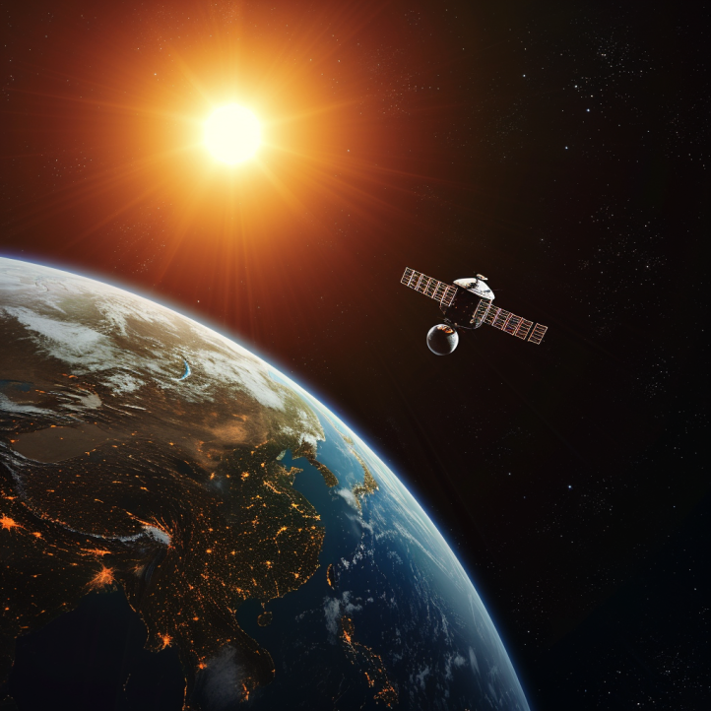
Different forms of sensing: Active vs Passive
Passive Sensing
Active Sensing

Slide 26
Different forms of sensing: Active vs Passive
Passive Sensing
Active Sensing
When we talk about embedded systems we focus on passive sensing. As It is much cheaper and at a lower energy consumption

Slide 27
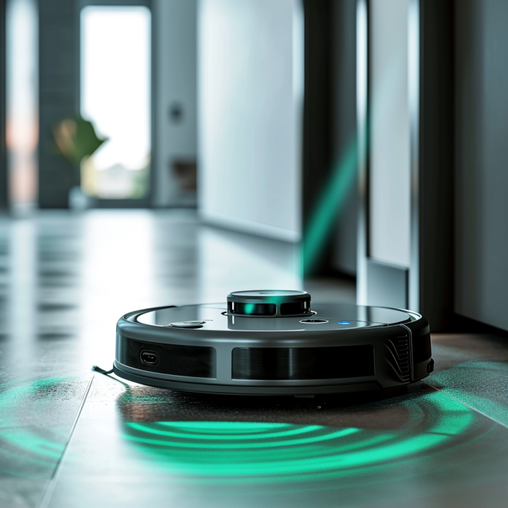
Identify passive/active sensing from applications?
Vacuum cleaners: Distance measurement using ultrasound and Lidar

Slide 28
Identify passive/active sensing from applications?
Vacuum cleaners: Distance measurement using ultrasound and Lidar
Active: Transmit acoustic signal (ultrasound) or laser (Lidar)

Slide 29

Identify passive/active sensing from applications?
Taking photographs under camera flash

Slide 30
Identify passive/active sensing from applications?
Taking photographs under camera flash: active sensing

Slide 31
Identify passive/active sensing from applications?
Taking photographs without camera flash: passive sensing

Slide 32
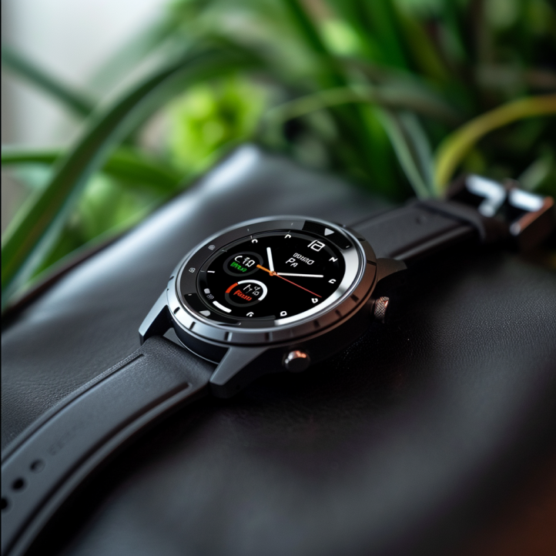
Identify passive/active sensing from applications?
Body temperature sensing on a smart watch?

Slide 33
Identify passive/active sensing from applications?
Body temperature sensing on a smartwatch? Passive sensing

Slide 34
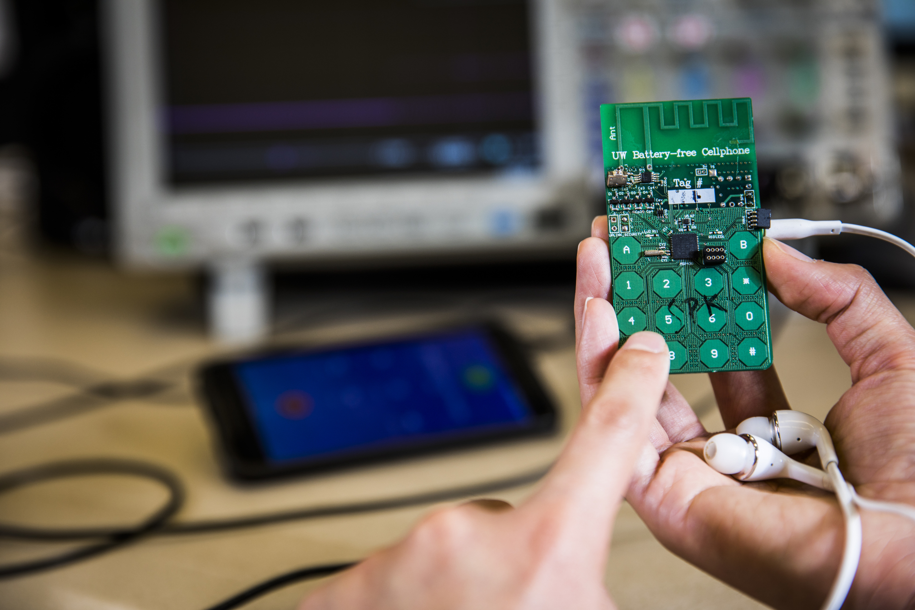
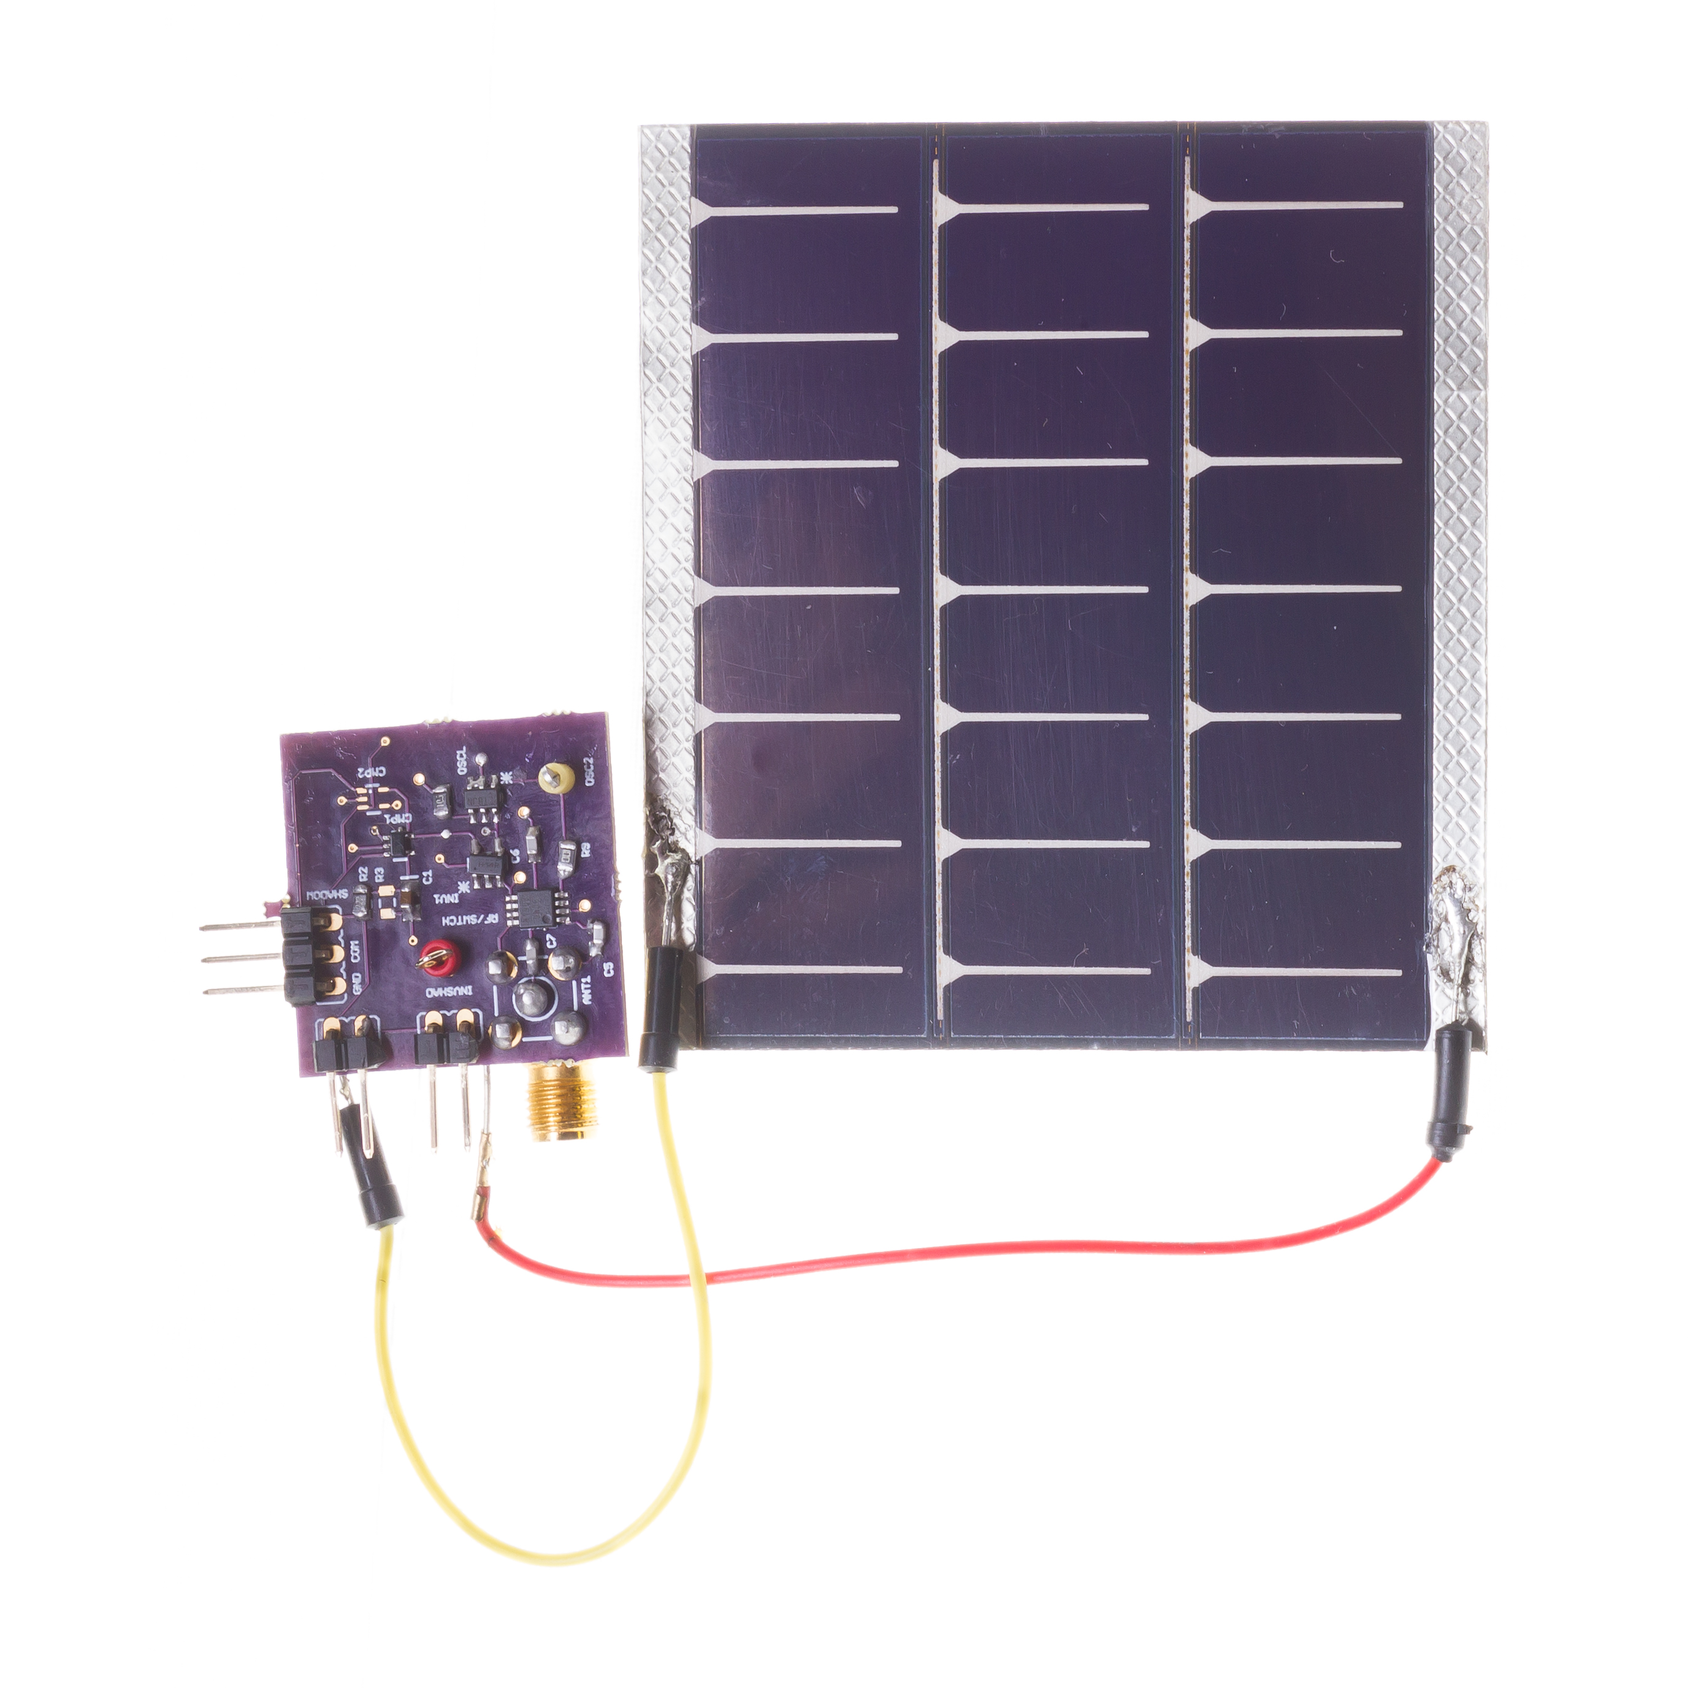
Sensors have become exceedingly energy-efficient
During past decades, sensors have become exceedingly energy-efficient
E.g., Accelerometer, Temperature, Image Sensors: Few µW’s of power
Mostly passive sensors in constrained wireless embedded devices

Slide 35
Break! Q&A (5 minutes)
Notes:
++ Over the past few years, I have designed several backscatter and beyond backscatter systems that precisely overcome these critical challenges that have limited the widespread deployment of backscatter on IoT devices.
++ The research vision that I have pursued and would like to pursue as a faculty member is to enable a massive deployment of IoT devices by bridging the energy asymmetry between sensing, computation and communication blocks by designing novel platforms and communication mechanisms. I am going to describe some of my research contributions next.

Slide 36
Roadmap of the lecture today
We review some of the important points from the last lecture
What are sensors? Two main categories of sensing modality
Basics of sensing, ADCs, and interfacing sensors with microcontroller
Sensing using potential changes, other sensors
Case study: Visible Light Sensing, Actuation
Notes:
Here is the roadmap of the major topics that I am going to cover during the presentation. We have already covered the exponential growth of the internet of things; next, I will talk about the critical energy challenge that can severely hinder this massive growth and preventing us from realising this immense economic value enabled by the IoT.

Slide 37
Digital microcontrollers, analog world, and sensors
Microcontrollers: Digital component designed to process digital signals. They interpret commands from the software programmed into their memory.
Analog vs. Digital: The physical world is inherently analog, meaning it varies continuously. A common example of an analog phenomenon is the fluctuation of temperature or humidity.
Sensors are devices that monitor physical phenomena and convert them into electrical signals. These electrical signals can then be processed by microcontrollers to support an embedded application

Slide 38
Sensors transform phenomenon into electrical signals
How sensors convert physical phenomena into electrical signals, we refer to Ohm's Law, which states that Voltage (V) equals Current (I) times Resistance (R)
V (Voltage) = I (Current) X R (Resistance)
By altering one of the variables in Ohm’s law —Voltage (V), Current (I), or Resistance (R)—in response to changes in the phenomenon, a sensor generates an analog electrical signal that corresponds to that phenomenon.

Slide 39
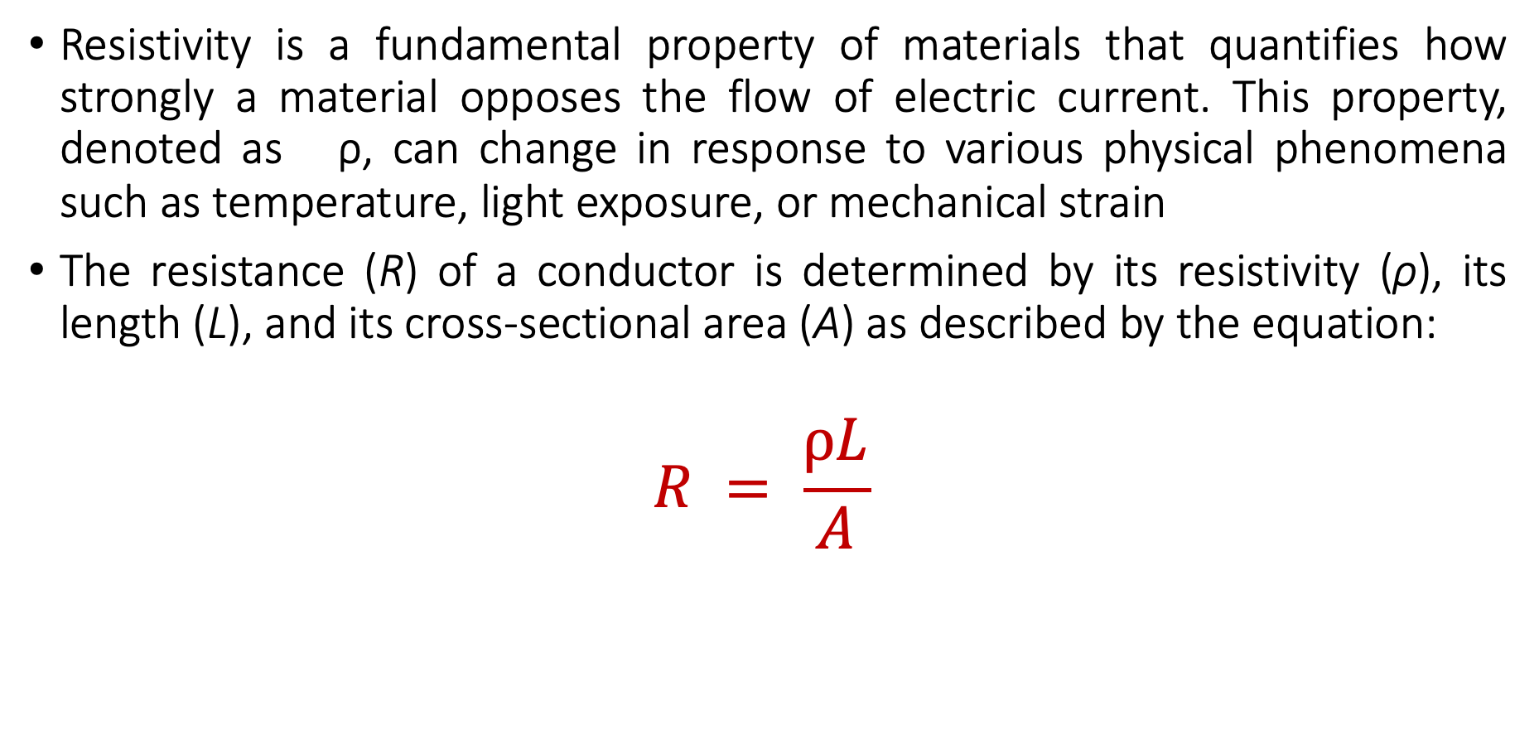
Material Resistivity and its Role in Sensing Phenomena
Resistivity is a fundamental property of materials that quantifies how strongly a material opposes the flow of electric current. This property, denoted as ρ, can change in response to various physical phenomena such as temperature, light exposure, or mechanical strain
The resistance (R) of a conductor is determined by its resistivity (ρ), its length (L), and its cross-sectional area (A) as described by the equation:
$$R = \frac{ρL}{A}$$

Slide 40
Material Resistivity and its Role in Sensing Phenomena
Resistivity is a fundamental property of materials that quantifies how strongly a material opposes the flow of electric current. This property, denoted as ρ, can change in response to various physical phenomena such as temperature, light exposure, or mechanical strain
The resistance (R) of a conductor is determined by its resistivity (ρ), its length (L), and its cross-sectional area (A) as described by the equation:
$$R = \frac{ρL}{A}$$

Slide 41
Material Resistivity and its Role in Sensing Phenomena
Resistivity (ρ): Materials with higher resistivity create more resistance for the same length and area. Resistivity is sensitive to physical conditions;
Temperature: Many conductors have higher resistivity at higher temperatures.
Light: Some materials (like photoresistors) change their resistivity exposed to light.
Strain: Materials known as strain gauges increase in resistivity when stretched.

Slide 42
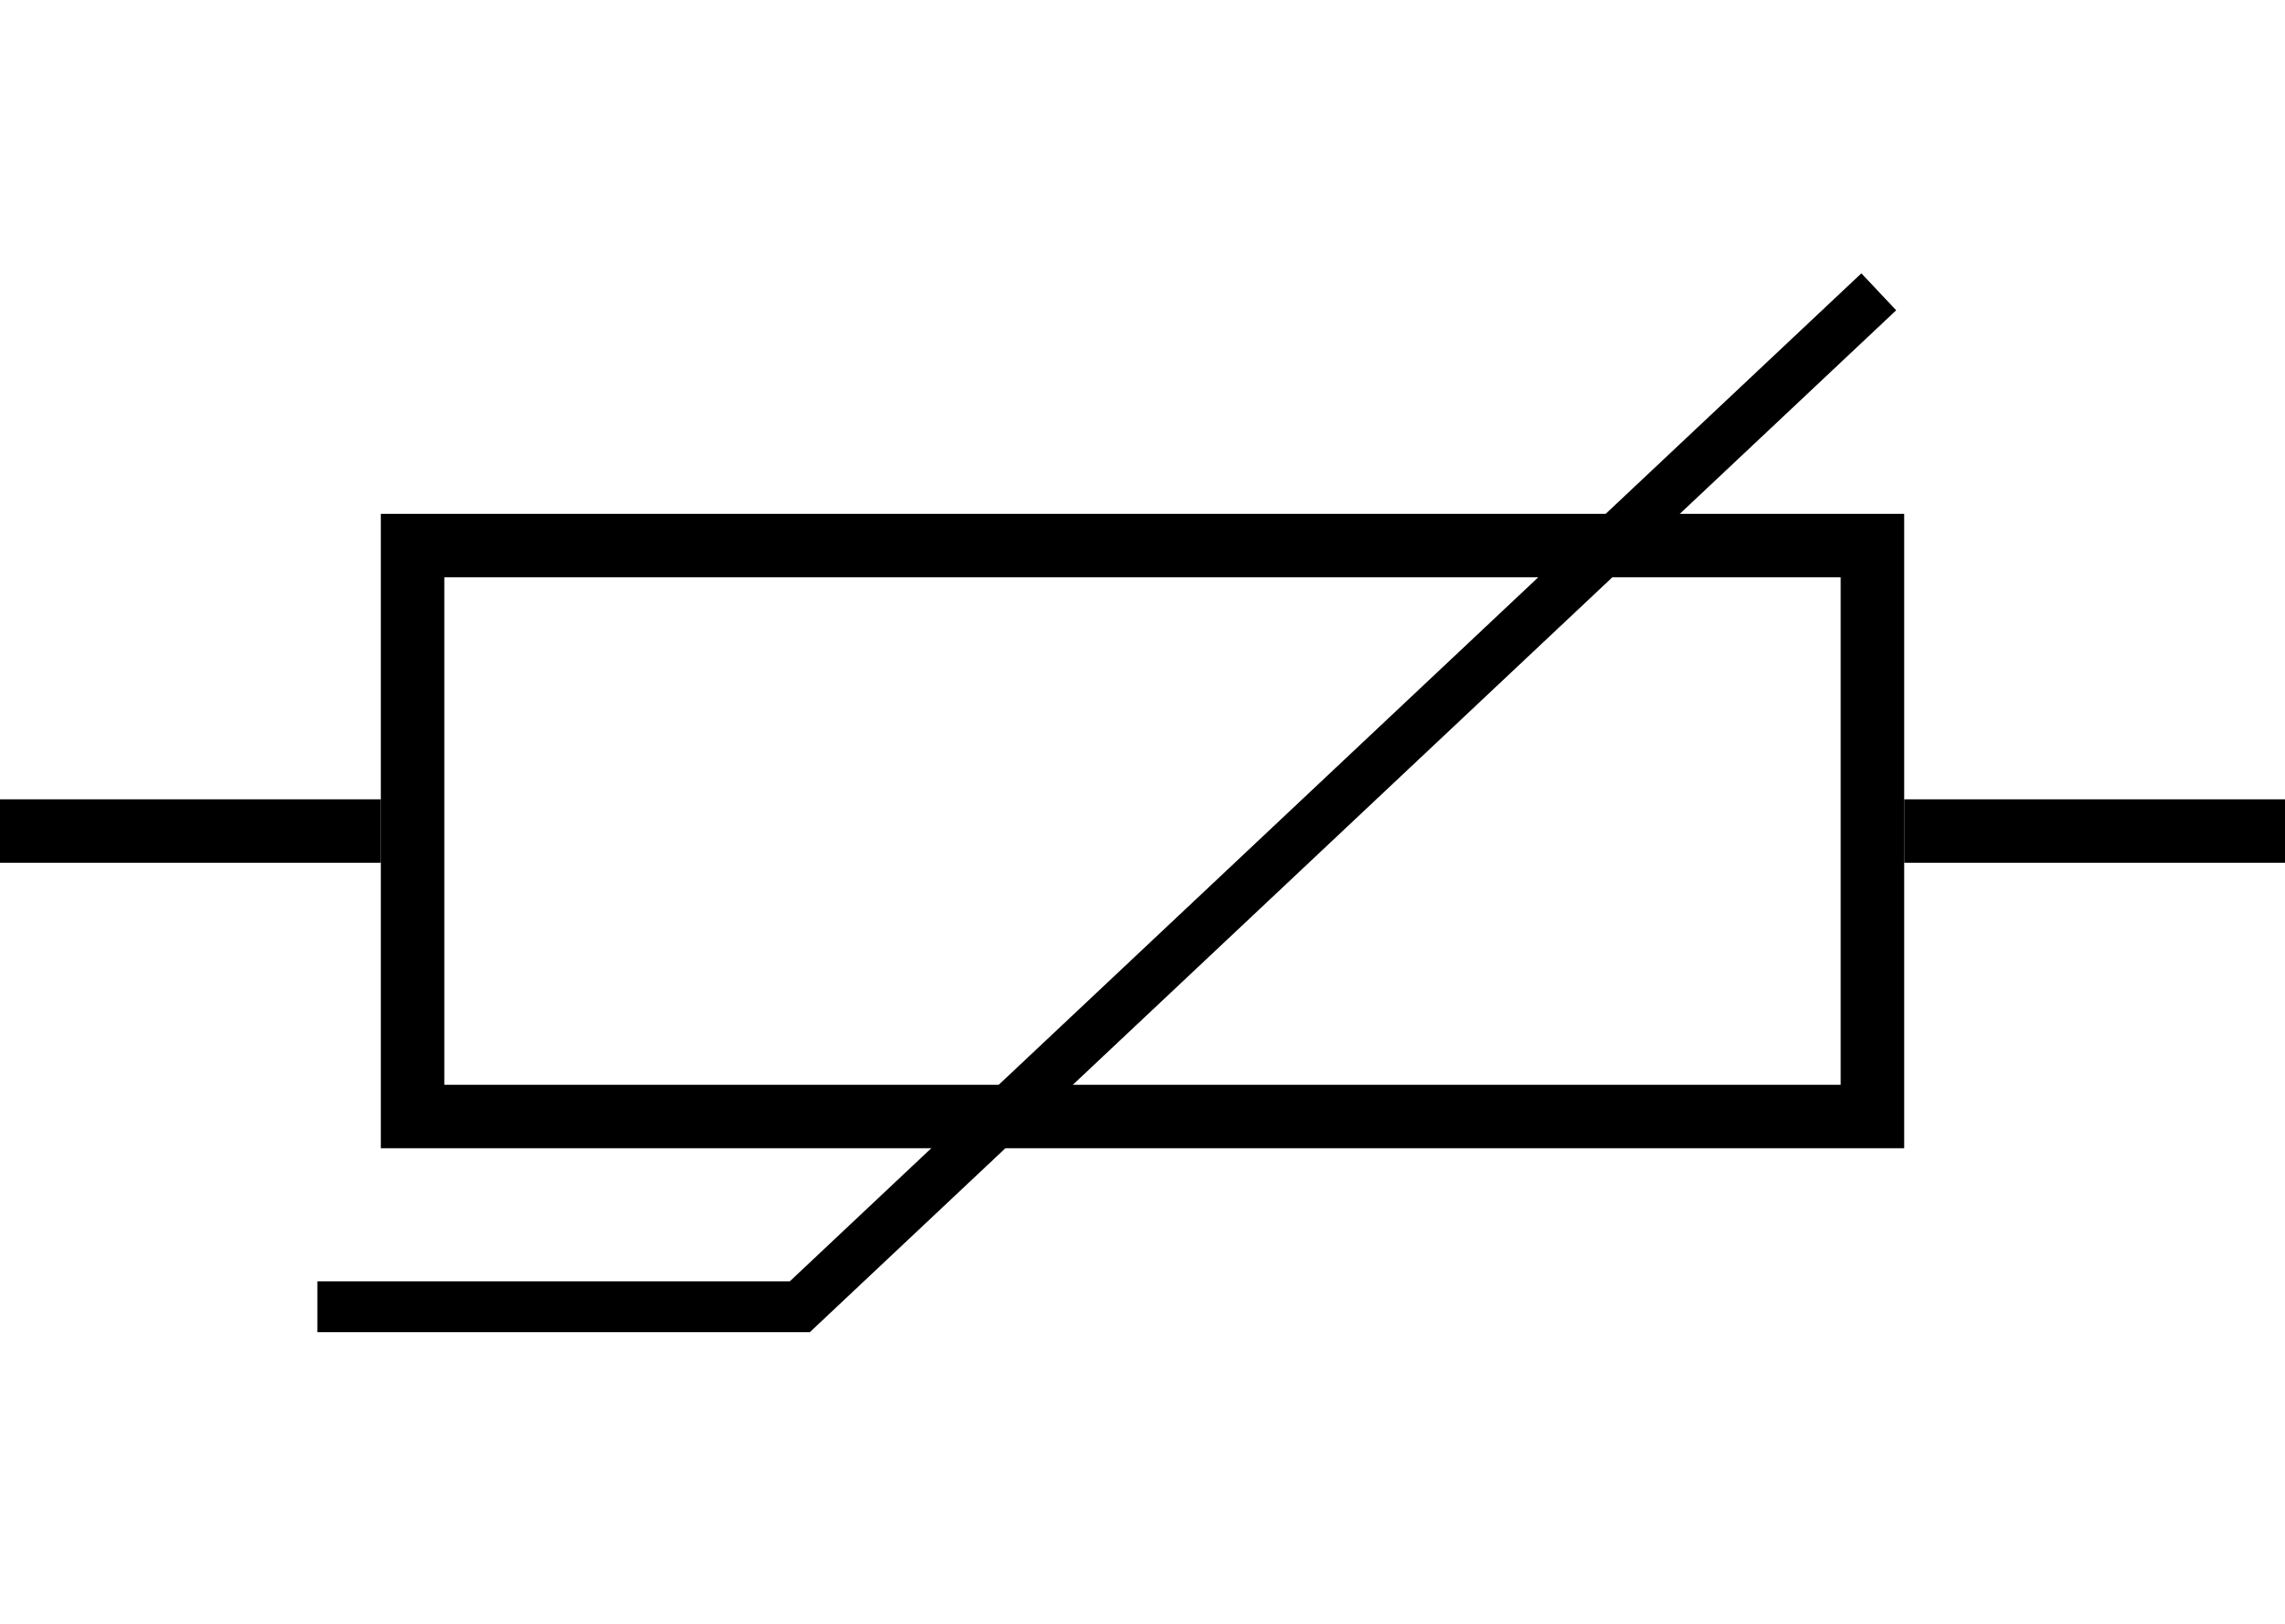
Temperature sensing using resistivity changes
Thermistor is a sensor which varies in resistance based on temperature
Advantages: They are cheap and easy to use. Low cost
Disadvantages: They have a non-linear transfer function

Slide 43
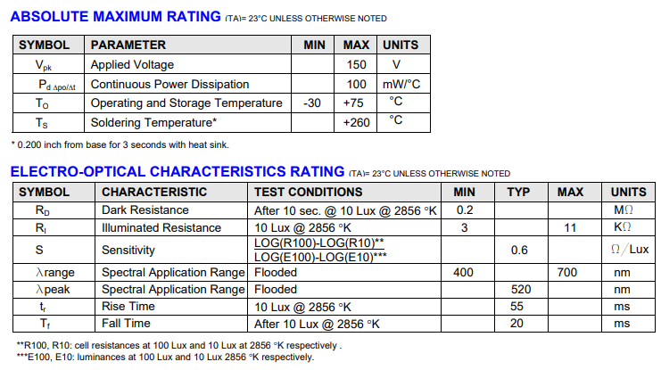
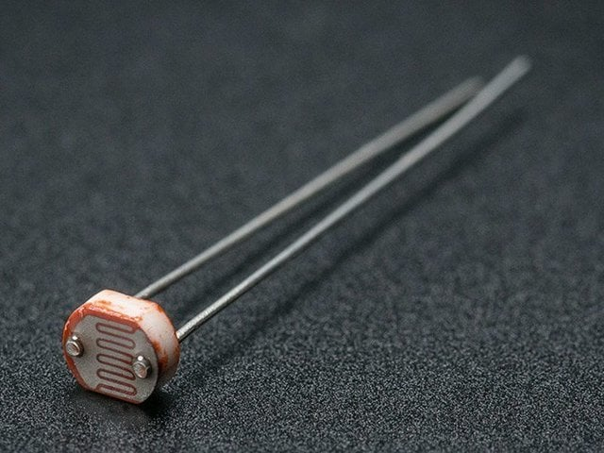
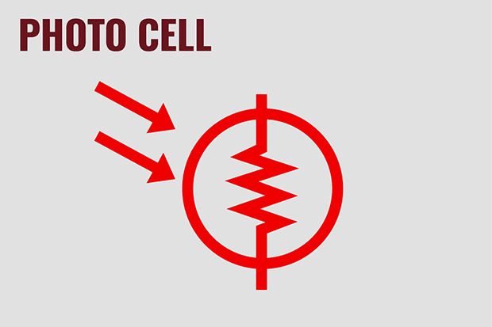
Light sensing using resistive changes
Photocell changes resistance with light (non-linear)
Example:
10 kΩ when dark
1 kΩ when light

Slide 44
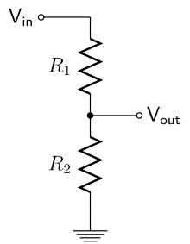
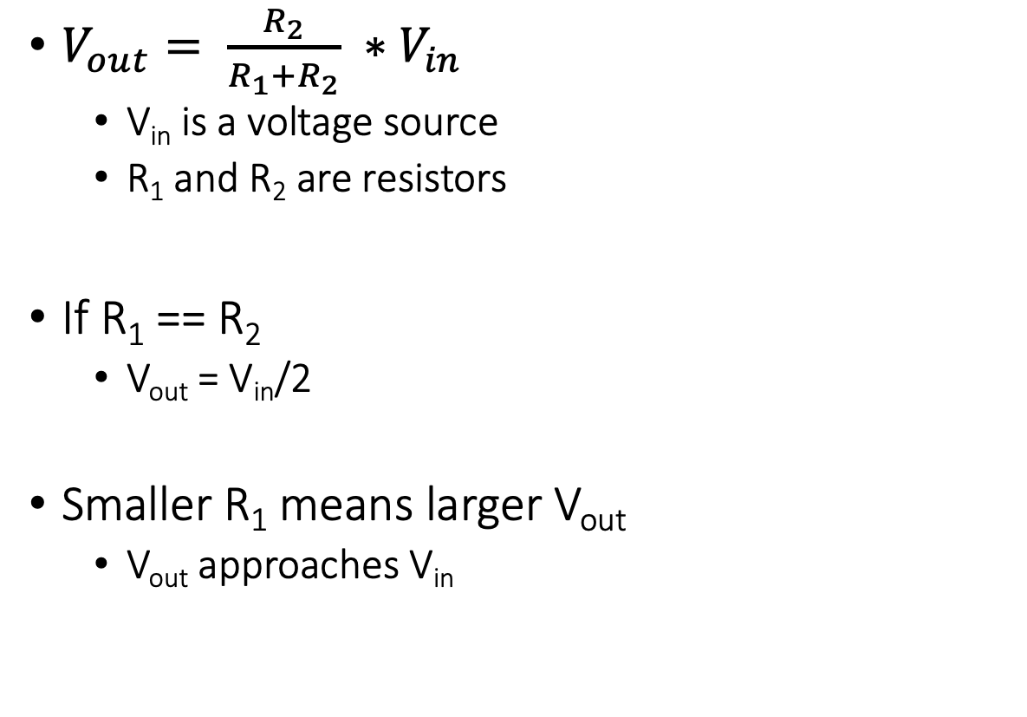
Let us go back to electronics basics: voltage dividers
$V_{out}= \frac{R_{2}}{R_{1}+R_{2}} ∗V_{in}$
V_{in} is a voltage source
R₁ and R₂ are resistors
If R₁ == R₂
V_{out} = V_{in}/2
Smaller R₁ means larger V_{out}
V_{out} approaches V_{in}

Slide 45
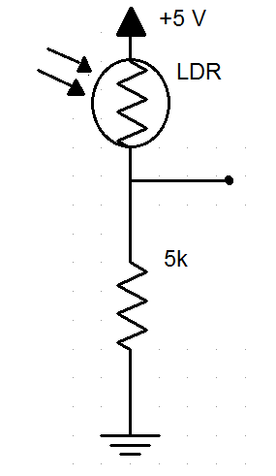
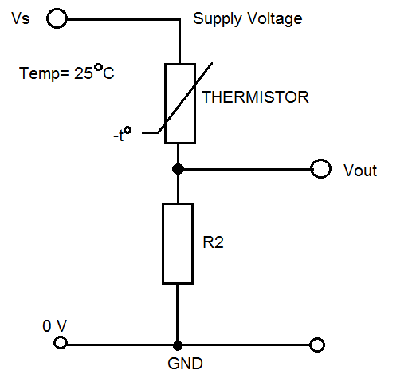
How do we measure a resistive sensor?
Place in series with resistor
Between VCC and ground
Measure voltage between the two relative to ground
Forms a “voltage divider”

Slide 46
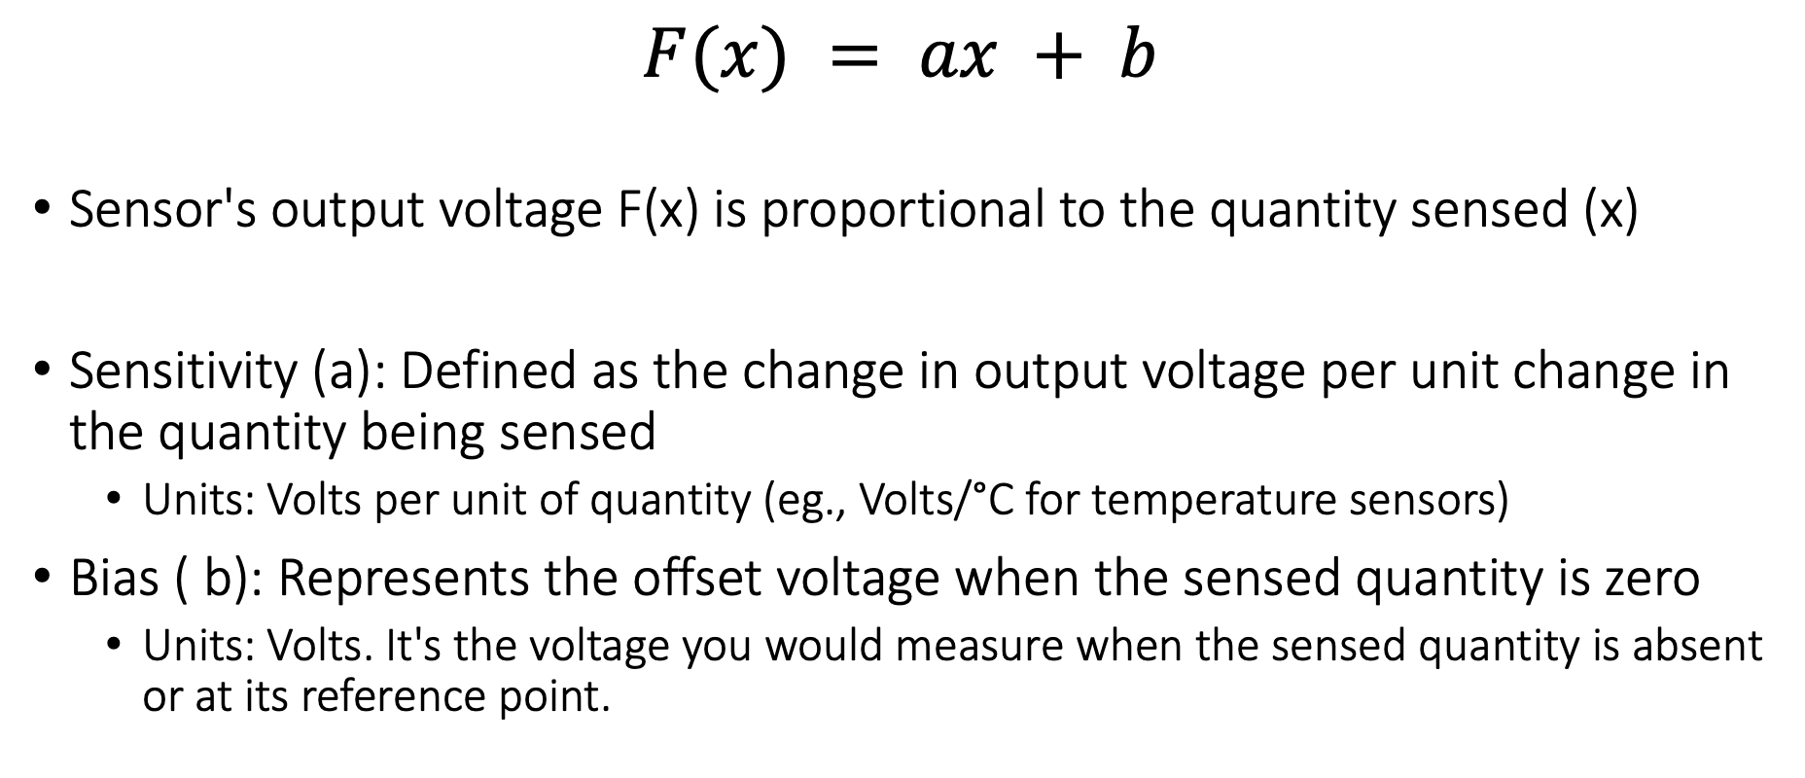
Linear Relationship in Sensing Applications
$$F(x) = ax + b$$
Sensor's output voltage F(x) is proportional to the quantity sensed (x)
Sensitivity (a): Defined as the change in output voltage per unit change in the quantity being sensed
Units: Volts per unit of quantity (eg., Volts/°C for temperature sensors)
Bias ( b): Represents the offset voltage when the sensed quantity is zero
Units: Volts. It's the voltage you would measure when the sensed quantity is absent or at its reference point.

Slide 47
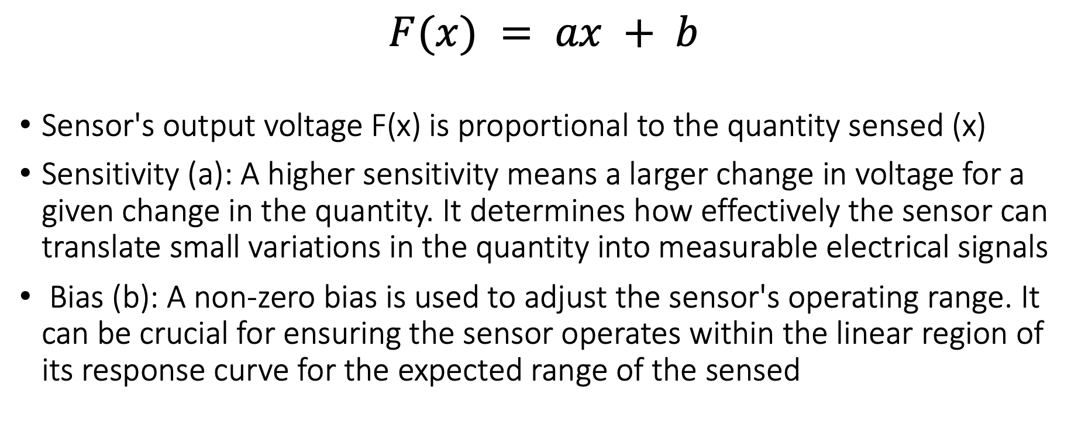
Linear Relationship in Sensing Applications
$$F(x) = ax + b$$
Sensor's output voltage F(x) is proportional to the quantity sensed (x)
Sensitivity (a): A higher sensitivity means a larger change in voltage for a given change in the quantity. It determines how effectively the sensor can translate small variations in the quantity into measurable electrical signals
Bias (b): A non-zero bias is used to adjust the sensor's operating range. It can be crucial for ensuring the sensor operates within the linear region of its response curve for the expected range of the sensed

Slide 48
Taking a step back: Microcontrollers are digital
Up to this point, we have talked about translating physical phenomenon to analog electrical signal changes
How do we convert the analog signal into digital?
Do we need to do any processing before the conversion operation?
Notes:
Why do the IoT platforms suffer from this energy challenge? To understand this, we investigate the architecture of the IoT device. We show this architecture in the figure on the slide. It consists of a series of stages that enable us to sense physical phenomena, process and transmit the sensor information through a transceiver such as ZigBee/BLE/LoRa.
This architecture has remained unchanged over the past two decades. We find that during this time, sensors have become exceeding efficient. Today, we find sensors such as an accelerometer or a temperature sensor consumes just a few tens of microwatts of power consumption. However, we find that rest of the architecture components that are shown in red colour remain significantly energy expensive. To understand the reason for this significant energy asymmetry, we look at the following slide.

Slide 49

Taking a step back: Microcontrollers are digital
Up to this point, we have talked about translating physical phenomenon to analog electrical signal changes
How do we convert the analog signal into digital?
Do we need to do any processing before the conversion operation?
Conventional and widely used architecture of embedded wireless platform
Notes:
Why do the IoT platforms suffer from this energy challenge? To understand this, we investigate the architecture of the IoT device. We show this architecture in the figure on the slide. It consists of a series of stages that enable us to sense physical phenomena, process and transmit the sensor information through a transceiver such as ZigBee/BLE/LoRa.
This architecture has remained unchanged over the past two decades. We find that during this time, sensors have become exceeding efficient. Today, we find sensors such as an accelerometer or a temperature sensor consumes just a few tens of microwatts of power consumption. However, we find that rest of the architecture components that are shown in red colour remain significantly energy expensive. To understand the reason for this significant energy asymmetry, we look at the following slide.

Slide 50
ADC: Bridging the analog and digital worlds
ADCs convert analog signals, which have a continuous range of values, into digital signals, which have discrete numerical representations. This is essential for digital devices to process real-world analog inputs
What are the various parameters of the ADC?
Resolution: Determined by the number of bits the ADC uses to represent the analog value. More bits mean higher resolution and finer granularity in the output
Sampling Rate: The frequency at which the ADC samples the analog signal. Higher sampling rates can capture more detail and are necessary to comply with the Nyquist theorem. It also means higher power consumption
Accuracy: The closeness of the ADC's output to the true input value. It includes factors such as linearity, noise, and error rate
Notes:
Why do the IoT platforms suffer from this energy challenge? To understand this, we investigate the architecture of the IoT device. We show this architecture in the figure on the slide. It consists of a series of stages that enable us to sense physical phenomena, process and transmit the sensor information through a transceiver such as ZigBee/BLE/LoRa.
This architecture has remained unchanged over the past two decades. We find that during this time, sensors have become exceeding efficient. Today, we find sensors such as an accelerometer or a temperature sensor consumes just a few tens of microwatts of power consumption. However, we find that rest of the architecture components that are shown in red colour remain significantly energy expensive. To understand the reason for this significant energy asymmetry, we look at the following slide.

Slide 51


ADC: Bridging the analog and digital worlds
Notes:
Why do the IoT platforms suffer from this energy challenge? To understand this, we investigate the architecture of the IoT device. We show this architecture in the figure on the slide. It consists of a series of stages that enable us to sense physical phenomena, process and transmit the sensor information through a transceiver such as ZigBee/BLE/LoRa.
This architecture has remained unchanged over the past two decades. We find that during this time, sensors have become exceeding efficient. Today, we find sensors such as an accelerometer or a temperature sensor consumes just a few tens of microwatts of power consumption. However, we find that rest of the architecture components that are shown in red colour remain significantly energy expensive. To understand the reason for this significant energy asymmetry, we look at the following slide.

Slide 52
How do you identify what type of sensor?
You need to learn how to read datasheets. They contain all the important information. Power, voltage, analog versus digital and others
Accelerometer: ADXL335 Datasheet
Accelerometer: ADXL345 Datasheet
Notes:
Why do the IoT platforms suffer from this energy challenge? To understand this, we investigate the architecture of the IoT device. We show this architecture in the figure on the slide. It consists of a series of stages that enable us to sense physical phenomena, process and transmit the sensor information through a transceiver such as ZigBee/BLE/LoRa.
This architecture has remained unchanged over the past two decades. We find that during this time, sensors have become exceeding efficient. Today, we find sensors such as an accelerometer or a temperature sensor consumes just a few tens of microwatts of power consumption. However, we find that rest of the architecture components that are shown in red colour remain significantly energy expensive. To understand the reason for this significant energy asymmetry, we look at the following slide.

Slide 53
Break! Q&A (5 minutes)
Notes:
++ Over the past few years, I have designed several backscatter and beyond backscatter systems that precisely overcome these critical challenges that have limited the widespread deployment of backscatter on IoT devices.
++ The research vision that I have pursued and would like to pursue as a faculty member is to enable a massive deployment of IoT devices by bridging the energy asymmetry between sensing, computation and communication blocks by designing novel platforms and communication mechanisms. I am going to describe some of my research contributions next.

Slide 54
Roadmap of the lecture today
We review some of the important points from the last lecture
What are sensors? Two main categories of sensing modality
Basics of sensing, ADCs, and interfacing sensors with microcontroller
Sensing using potential changes, other sensors
Case study: Visible Light Sensing, Actuation
Notes:
Here is the roadmap of the major topics that I am going to cover during the presentation. We have already covered the exponential growth of the internet of things; next, I will talk about the critical energy challenge that can severely hinder this massive growth and preventing us from realising this immense economic value enabled by the IoT.

Slide 55

Beyond resistive changes sensing: Potential
Thermocouple generates a voltage based on temperature
This principal is also used to enable harvesting energy from heat energy

Slide 56

Generating voltage via piezoelectric effect
Compression of the material generates a voltage
Various sources of compression:
Air Pressure
Acceleration
Strain

Slide 57


Beyond resistive changes sensing: Potential
Generate a change in voltage that changes based on force

Slide 58


Motion sensing: accelerometers
Accelerometers usually measure in g’s
Where 1 g equals acceleration due to Earth gravity
Determining distance from acceleration is possible
But messy. Error is squared when integrating
Needs careful filtering and is only accurate over short periods
Often fills in gaps between GPS samples (or other localization systems)
Accelerometers also work as tilt sensors
Constantly sensing pull of gravity
$A[x] = 1 g ∗ sin⁡(θ)$

Slide 59
Motion sensing: Inertial measurement unit (IMU)
IMUs (a.k.a 9 degree-of-freedom, 9DOF) track motion of a device
Acceleration (X, Y, Z axes)
Rotation (X, Y, Z axes)
Magnetism (X, Y, Z axes)
Sometimes 6DOF with Acceleration + one of the others
Intelligent sensing: combines multiple sensors, ADCs, and computation with a wired interface
9 analog inputs would otherwise be too many
Can be used to track motion, determine transportation method
Smartphones, Robotics, etc.

Slide 60

Motion sensing: Inertial measurement unit (IMU)
Courtesy: Apple

Slide 61

Microelectromechanical Systems (MEMS)
Same sensing concept, but within an IC and 1 to 100 micrometers in size

Slide 62

Beyond resistive changes sensing: Deformations
Heat bends a strip of two different metals. This switches circuit on/off based on the temperature applied to the bimetallic strip
Application: Fridge! Older models

Slide 63


Other sensors: magnetic field (magnetometer)
Measures the magnetic field. Usually used in devices as a compass
Detect Earth’s magnetic field orientation
Satellites also often use magnetometers for localization
Courtesy: Adafruit

Slide 64



Even more types of sensors
Environment: Pressure, Humidity, Air Velocity, Air Quality
Rotation: Gyroscope
Distance: Ultrasonic, Lidar, or Radar
Biometric: Pulse Oximeter, Heart Rate
Agricultural: Soil moisture

Slide 65
Roadmap of the lecture today
We review some of the important points from the last lecture
What are sensors? Two main categories of sensing modality
Basics of sensing, ADCs, and interfacing sensors with microcontroller
Sensing using potential changes, other sensors
Case study: Visible Light Sensing, Actuation
Notes:
Here is the roadmap of the major topics that I am going to cover during the presentation. We have already covered the exponential growth of the internet of things; next, I will talk about the critical energy challenge that can severely hinder this massive growth and preventing us from realising this immense economic value enabled by the IoT.

Slide 66

Light sensing: Photodiodes
Most common type of light sensing mechanism
When voltage is applied in reverse to an ideal diode, no current flows
But some small amount of current leaks for real-world photo diodes
Proportional to light levels!

Slide 67


How do we measure light?
Lux: unit of illuminance

Slide 68

Light sensing mechanisms are energy expensive
Energy expensive light sensing mechanism (mWs)
Photodiodes coupled with an amplifier
Analog to digital converters (ADCs)
Computational blocks – MCU/FPGA

Slide 69

Battery-free Visible Light Sensing

Slide 70

Visible Light Marker Schematic
Light sensing
Digitisation
Communication without processing

Slide 71
Solar cell for passive Visible Light Sensing
Solar cells passive requires no external power
Eliminates energy expensive photodiodes and amplifiers
Enables energy harvesting to support battery-free operations
Operate under diverse light conditions (100 lux to 80k lux )
Reduces energy consumed for sensing to zero!

Slide 72
Selecting solar cell for visible light sensing
Cast shadow on different types solar cell
Indoor light level : 200 lx
Shadow causes significant change in SNR for all solar cells
Significant change in SNR in presence of shadow

Slide 73
Digitizing at µWs of power
Multibit Analog to digital converters (ADC) are energy expensive
Periodic polling to detect shadow events
Many sensing applications do not require such high resolution
Thresholding circuit acts like 1-bit ADC
No polling required, responds to shadow event
Peak power consumption: 0.5 µW

Slide 74

Power consumption
Module | Power consumption
Solar cell | 0
Thresholding circuit | 0.5 $μW$
Scatterlight (100 kHz – 1 MHz) | 19.5 $μW$ – 120 $μW$

Slide 75






Application: Gesture recognition

Slide 76

Demo – Gesture recognition
Shift ambient FM station to transmit shadow event

Slide 77

What are actuators?
Actuator is an electronic component that modifies a physical quantity
Light/LED
Motor
Speaker
…….
Notes:
First, we look at the computational elements, and these consist of a microcontroller or an FPGA. Today, we find that these computational elements consume at least one order of magnitude higher power consumption when compared to the commonly used sensors.
However, we also find that microcontrollers are increasingly becoming energy efficient. We investigate a typical microcontroller that has been used in sensor platforms over the past two decades. We find that energy efficiency has improved by almost two orders of magnitude. Some of the present-generation microcontrollers, such as Ambiq Apollo4 consume just 3 uA/MHz than 330 uA for MSP430 used on platforms such as TelOS B.
If the trend continues, we can expect the microcontrollers to catch up with the sensors and become energy-efficient. This significant improvement is that the digital components are increasing becoming efficient as they follow moore’s law.

Slide 78

Actuation is energy expensive (wrt sensing)
Notes:
First, we look at the computational elements, and these consist of a microcontroller or an FPGA. Today, we find that these computational elements consume at least one order of magnitude higher power consumption when compared to the commonly used sensors.
However, we also find that microcontrollers are increasingly becoming energy efficient. We investigate a typical microcontroller that has been used in sensor platforms over the past two decades. We find that energy efficiency has improved by almost two orders of magnitude. Some of the present-generation microcontrollers, such as Ambiq Apollo4 consume just 3 uA/MHz than 330 uA for MSP430 used on platforms such as TelOS B.
If the trend continues, we can expect the microcontrollers to catch up with the sensors and become energy-efficient. This significant improvement is that the digital components are increasing becoming efficient as they follow moore’s law.

Slide 79
Roadmap of the lecture today
We review some of the important points from the last lecture
What are sensors? Two main categories of sensing modality
Basics of sensing, ADCs, and interfacing sensors with microcontroller
Sensing using potential changes, other sensors
Case study: Visible Light Sensing, Actuation
Notes:
Here is the roadmap of the major topics that I am going to cover during the presentation. We have already covered the exponential growth of the internet of things; next, I will talk about the critical energy challenge that can severely hinder this massive growth and preventing us from realising this immense economic value enabled by the IoT.

Slide 80
Readings for this week/Assignment
Investigate datasheets linked on course page and identify type of sensors
Continue to investigate papers for presentation in the student seminar
Notes:
Here is the roadmap of the major topics that I am going to cover during the presentation. We have already covered the exponential growth of the internet of things; next, I will talk about the critical energy challenge that can severely hinder this massive growth and preventing us from realising this immense economic value enabled by the IoT.

Slide 81
Embedded Software Programming
Ambuj Varshney
ambujv@nus.edu.sg
Notes:
++ Thank you for inviting me to give this talk
++ In this talk, I will present a pathway that can enable us to make wireless embedded systems ubiquitous. I will describe my previous research efforts that tackle the critical challenges that limit the growth of wireless embedded systems. These are related to the growing energy asymmetry that exists between sensing, computation and communication blocks on these platforms.
++ Finally, I will conclude my talk by covering the research agenda that I would like to work on as a faculty member.

